Slide 1


WebTech Presentation
Delivery System of an E-commerce site
An Nazmus Sakib 20-43056-1

Slide 2
Technology used
PHP
Backend validation MySQL Data Fetch Login & Logout System
MySQL
Store Data
JavaScript
Animations UI & UX
Manage Relation among data

Slide 3
E-commerce Delivery system is a complex process among buyer seller. But an organize application can make it hassle free
Our application can be used for improved delivery service, leading to enhanced customer satisfaction. improved utilisation of business resources, resulting in effective cost-cutting. clearer visibility of IT costs and business assets

Slide 4
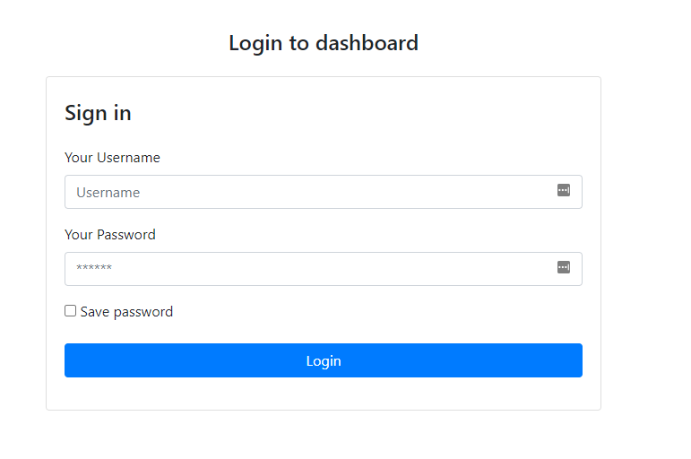
LOGIN Page
User will fill the inputs and it will get to server via $_POST[‘input’] method
Validation.php file will validate those inputs
Frist of all inputs will be matched with database users table
If it match we will simply redirect the user to index.php(main) page
If not form will continue show error to prevent any phishing attack

Slide 5
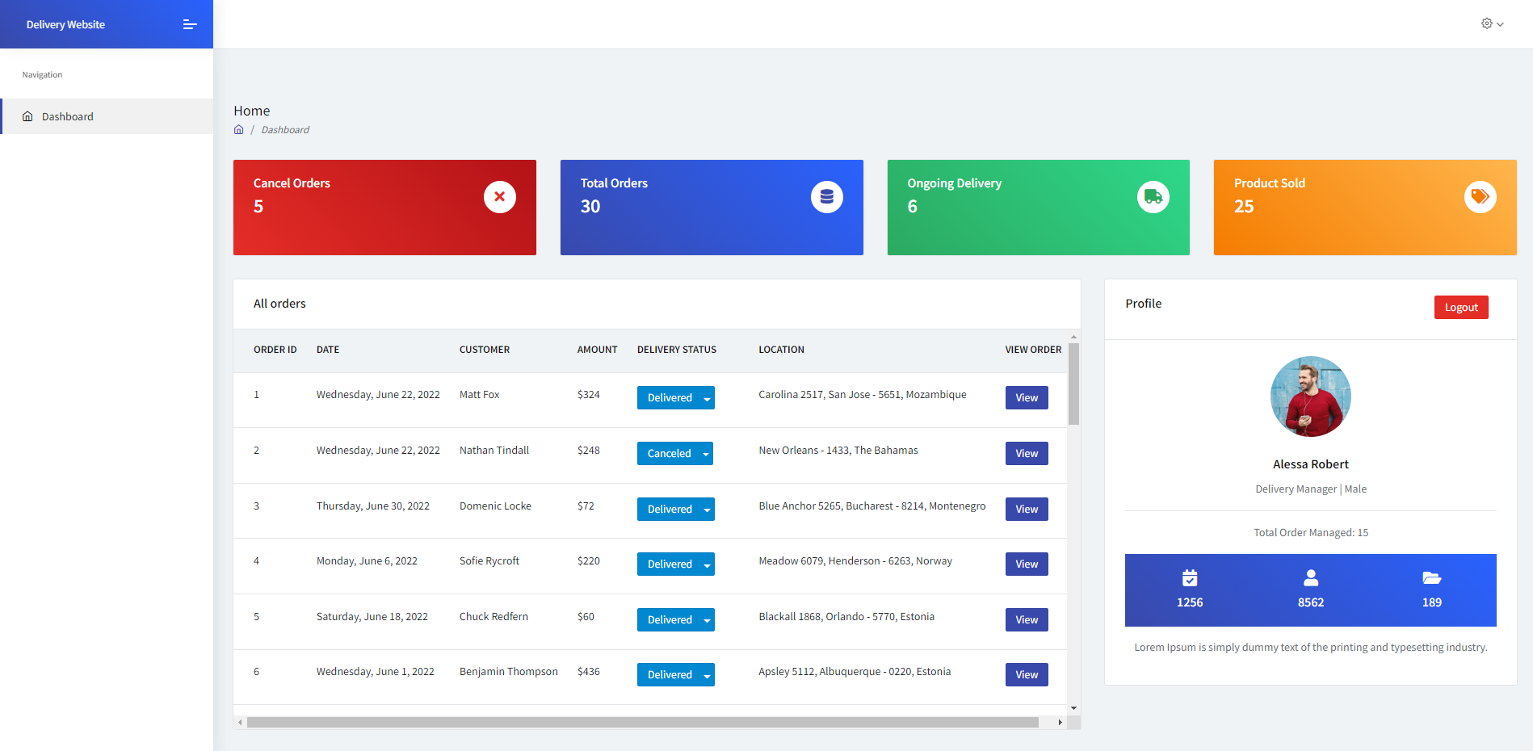
This is our admin dashboard page
The main key features are here
Total Orders analysis
Full order table system
View order history by one click

Slide 6
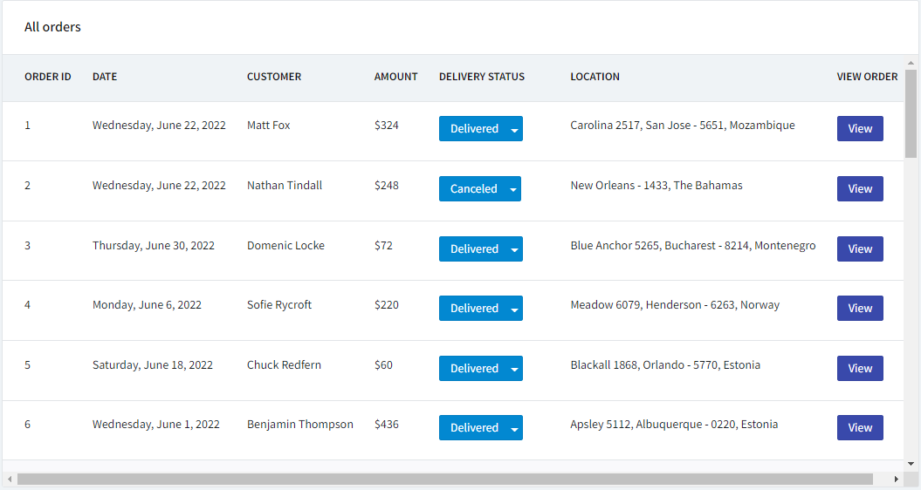
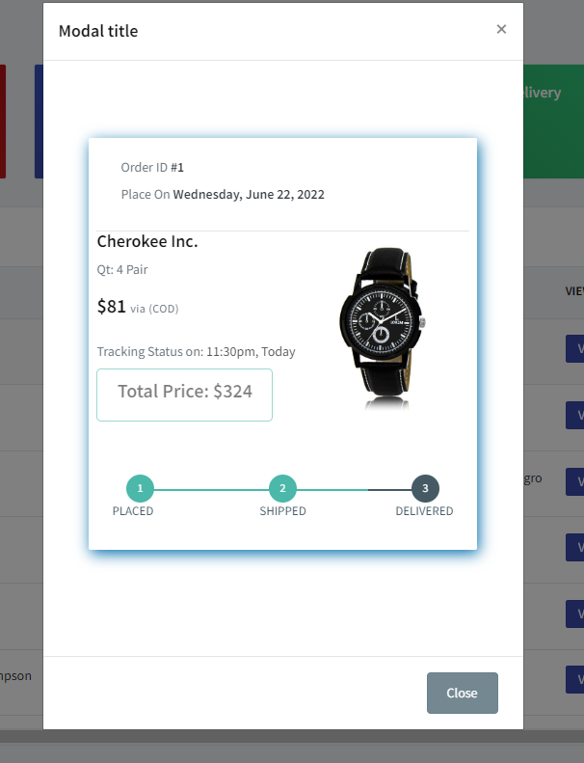
Orders Table view system
In includes folder we have our database connection setup
Using that functions we can easily fetch all the data using mysqli_fetch() function and store them in a result variable. If we going to loop through that simple array variable we will get this nice table
We also have modal view system to have a in-depth look on the order

Slide 7
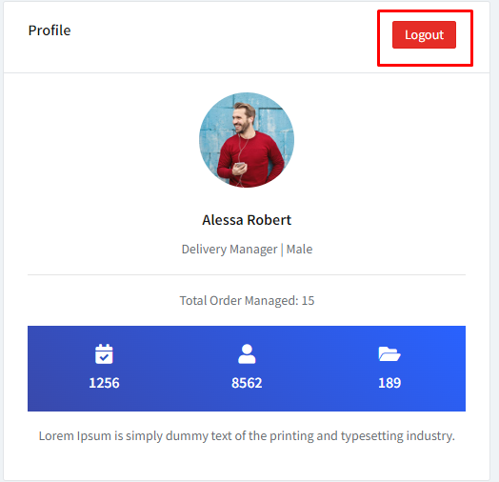
Logout system
We do have a logout system a the profile card corner.
It will destroy all our login Session using session_destroy() function and header(“Location:login.php”) function will redicret the user to the login page again

Slide 8
Thank You

